Slide 1
CSS ( Cascading Style Sheet)
Universitas Muhammadiyah Surakarta
Yogiek Indra Kurniawan

Slide 2
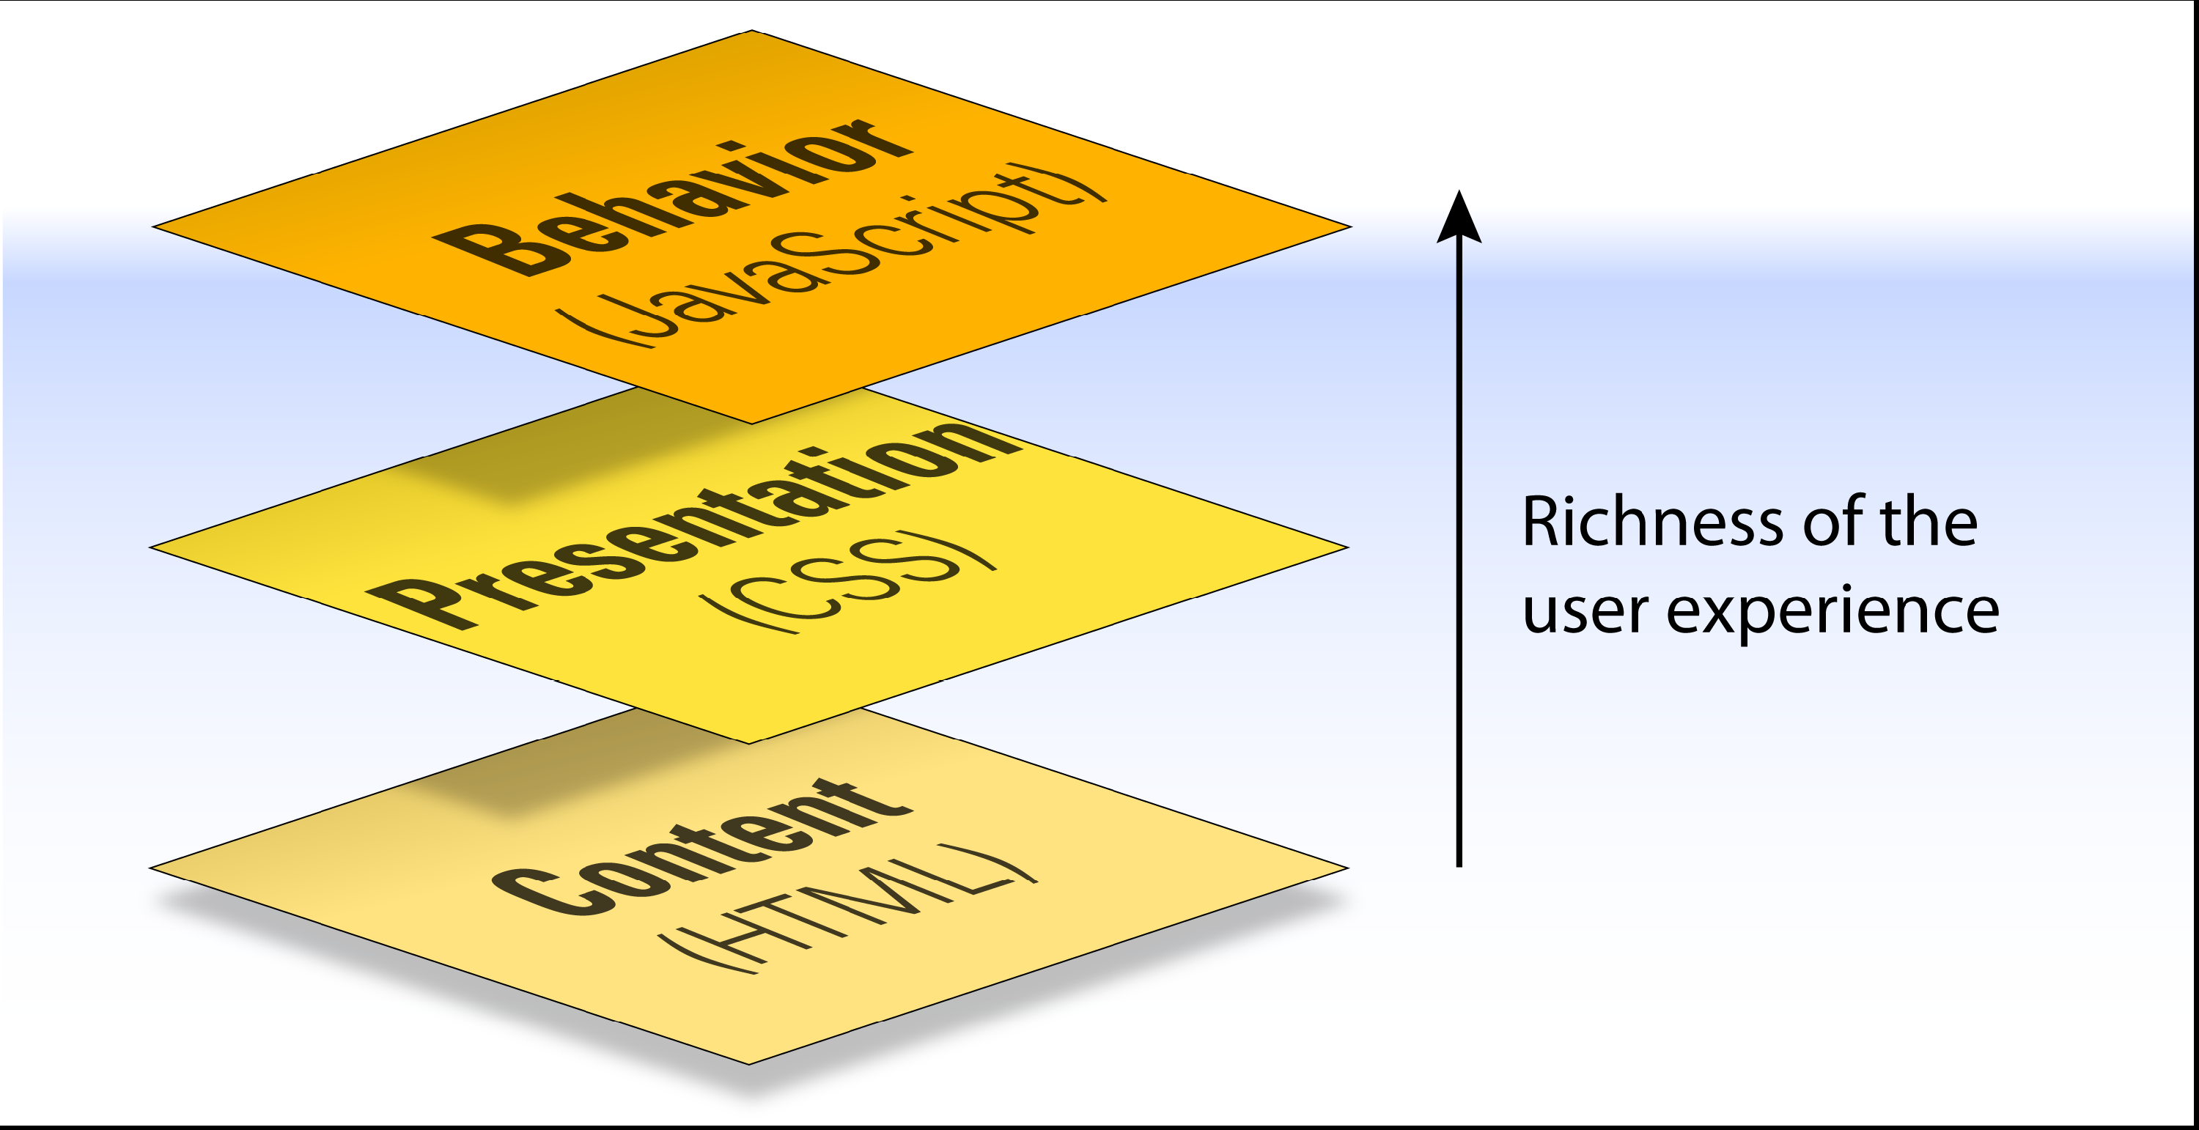
Three Layers Of Web

Slide 3
Old style
<font size=“small” face=“Arial”> bla...bla</font>
<body background=“#DEDEDE”> … </body>

Slide 4
Old Style
Table Layout
Tag attribute / style
Static page/file

Slide 5
Benefits ?
More Efficient
Save Bandwidth
Simple
Easy to Use

Slide 6

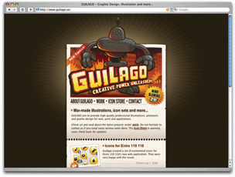


Slide 7
How to Use ??
Inline Styles
Applied via style attribute
Embedded Styles
Declare CSS in your web pages
External Style Sheets (Link)
Recommended!!

Slide 8
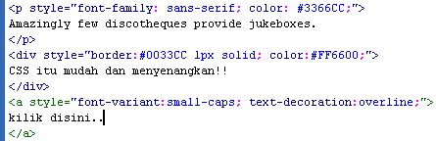
Inline
Penambahan di setiap TAG pada attribute style,

Slide 9
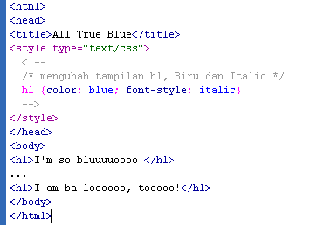
Embedded
Style element dideklarasikan diawal, menggunakan TAG : <style> … </style>

Slide 10

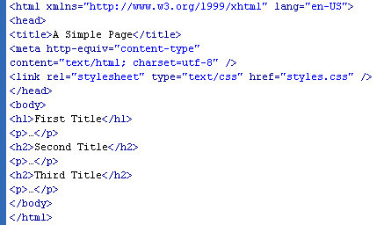
External (link)
style dibuat dalam file terpisah (.css), kemudian bisa dipanggil pada setiap file document (.html)
File.html
styles.css

Slide 11
CSS Selectors
1. TAG / ELEMEN
p, td, th, div {
font-size: 1em;
color: #FF0000;
}

Slide 12
2. Free Selector
<html>
<head>
<title> Free Selector </title>
<style type="text/css">
gbawah{text-decoration: underline;}
</style>
</head>
<body>
<gbawah> Underline with free selector</gbawah>
</body>
</html>

Slide 13
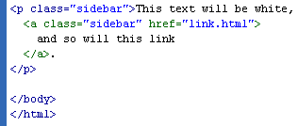

3. Class Selectors
Selector that use to be class attribute
.html / .php
.css

Slide 14
Class Selector Example
<html>
<head>
<title> Selector - Class </title>
<style type="text/css">
.modification {font-family:Verdana; font-size:16px; text-align:center}
</style>
</head>
<body>
<p class="modification">Modify with Class Selector</p>
</body>
</html>

Slide 15


4. ID Selectors

Slide 16
ID Selector Example
<html>
<head>
<title> Selector - ID </title>
<style type="text/css">
#example {
font-family:Arial, Helvetica, sans-serif;
font-size:16px;
font-style:italic
}
</style>
</head>
<body>
<p id=“example">Modify with ID Selector</p>
</body>
</html>

Slide 17
Next : PHP
Please
Bring Your Laptop!
Install XAMPP!

